Slide 1
Lifestyle Medicine and Culinary Medicine: Paths to Manage Chronic Lifestyle-Related Conditions
Cate Collings, MD, MS, FACC, DipABLM
President, ACLM
Director, Lifestyle Medicine El Camino Health
Notes:
I am please to welcome today’s speaker….
Dr. Cate Collings is the current President of ACLM and a board-certified practicing cardiologist in Silicon Valley. She received her BS at the University of California and her MS in Exercise Physiology followed by an MD degree at the University of Wisconsin. Returning to California, her residency and cardiology fellowship training were completed at Stanford University Medical Center. Dr. Collings established and provides ongoing medical directorship to the El Camino Hospital Cardiopulmonary Wellness Center targeting lifestyle measures to improve the health of cardiac patients. In addition to her clinical work, she is developing a Women’s Heart Center to focus on women specific cardiovascular disease management and on the unique application of lifestyle competencies to women and their family’s heart health. Dr. Collings joined the ACLM Board in 2015 to bridge to the cardiology community and promote lifestyle intervention on equal footing with other cardiovascular interventions.
And now, I turn it over to Dr. Collings.

Slide 2
Objectives
Define Lifestyle Medicine (LM) and understand why LM is an imperative now
Explore examples of LM programs and foundational research
Identify LM education opportunities and board certification
Understand unique methods used in LM practice
Define and differentiate Culinary Medicine (CM) and traditional nutritional counseling
Evaluate the Culinary Medicine Curriculum (CMC) for use in your health professional training program or clinical practice
Gain resources for further knowledge in LM and CM
Notes:
Thank you Paulina and welcome everyone, may I say, paritcularly those of you who are new to LM.
What is Lifestyle Medicine and how it approaches treatment from a different lens and has different goals
Why LM is more important than ever-why it is an imperative NOW
Show how LM is firmly rooted in evidence and guidelines
Talk about some of the unique methods used in LM practices
State of the art on education
Where we, at the national level, want LM to head in the next years

Slide 3
WHAT IS LIFESTYLE MEDICINE
Evidence-based therapeutic interventions

Slide 4
Lifestyle Medicine Defined
Lifestyle Medicine is the use of evidence-based lifestyle therapeutic approaches-including a whole food, plant-predominant eating pattern, regular physical activity, restorative sleep, stress management, avoidance of risky substances and positive social connection-as a primary therapeutic modality, delivered by clinicians trained and certified in this specialty, to prevent, treat, and often reverse chronic disease

Slide 5
6 Powerful Interventions
Nutrition
Sleep
Exercise
Substance Use
Stress Management
Social Connection
Notes:
We will look at some of the evidence for each these 6 LM interventions or domains a bit later

Slide 6
Where does Lifestyle Medicine Fit?
Medical Discipline | Key Care Approach
Preventive Medicine | Early Detection/Screening/ Environmental Safety/Public Health
Allopathic Medicine | Symptom Focused/Pharmacologic/Procedural
Functional Medicine | Novel Diagnostic Blood Work/Nutraceuticals/Supplements
Integrative Medicine | Blended Complementary and Conventional Approach
Lifestyle Medicine | Root Causes/Lifestyle First Interventions for Treatment and Remission
Notes:
But let's start by looking at where does LM fit in medicine overall. I know when I first explored LM, it was important to me to understand the distinction between LM and other medical disciplines. I the comparisons I share today, remember that the divisions are not always sharp. I believe medicine is both art and science and many practitioners use methods from more than one disciplines and there is no benefit from competition. Nevertheless, there are very important comparisons to consider when we put a name to something. Preventive Medicine is by it's name, focused on prevention and early detection and screening. Allopathic Medicine is the field most of us trained and approaches patient care through the lens of management of symptoms largely through a main course of diagnostic, pharmacologic and procedural means. Functional Medicine more often utilizes novel diagnostic blood tests and may include the use of nutraceuticals and supplements. Integrative Medicine often blends complementary and conventional medicine approaches. While lifestyle counseling is not new to any of us, Lifestyle Medicine as an interventional treatment for established disease is new. LM takes a root cause approach using a lifestyle first approach with a goal to actively treat and often reverse disease. LM requires active patient engagement and offers the patient the ability, through their everyday lifestyle habits, to be the locus of control of much of their health destiny.

Slide 7
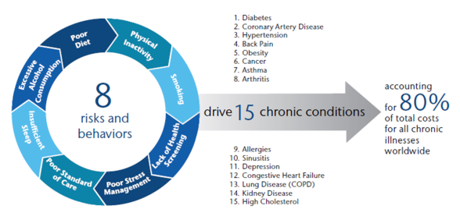
Lifestyle Medicine focuses are the conditions that consume 80% of healthcare visits, hospitalizations, and costs
Notes:
In this health care survey report, 8 risks and lifestyle behaviors were demonstrated to drive the top15 chronic conditions that comprise 80% of healthcare visits, hospitalizations and costs. These are the majority of the patients we see every day which is why lifestyle interventions need to become the first line and foundation of healthcare.
Graph of Diagnoses numbers
Source: https://www.aon.com/attachments/human-capital-consulting/2012_Health_Care_Survey_final.pdf
Sources: AON Hewitt, 2012.

Slide 8
WHY NOW
The need for Lifestyle Medicine
Notes:
LM can't wait and I want to share with you the state of affairs when it comes to lifestyle born diseases and why it is so important now

Slide 9
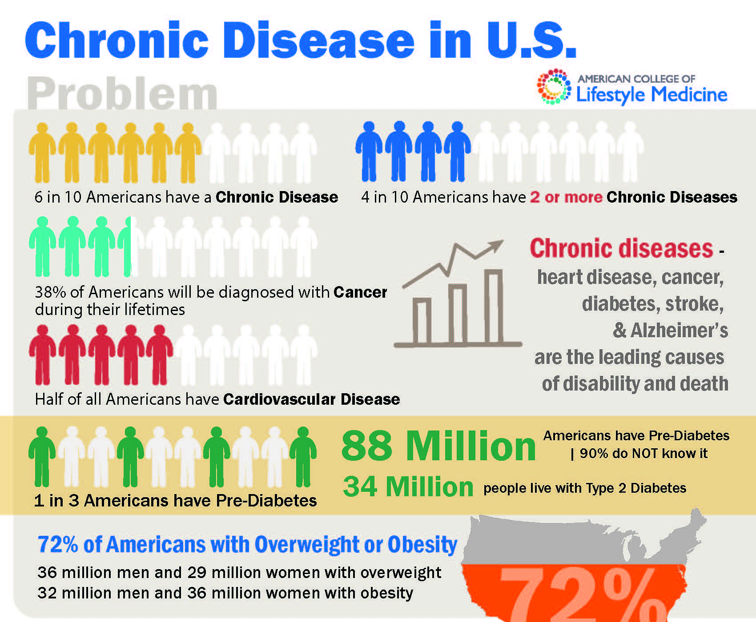
Unsustainable Economics
Healthcare in US costs $3.3 trillion annually
80% of these costs are attributed to the treatment of chronic conditions
Increasing Prevalence
Increase prevalence of obesity and diabetes
Patients with diabetes can expect 2.3x higher medical expenditures than general population
See Reference Appendix
Notes:
Said simply, we have an enormous chronic disease epidemic n the US, one that has been our watch for decades. This information and graphic are from the CDC. 6/10 people are sick with 1 or more chronic disease, despite all of our spending people are still sick - US Healthcare Spend = $3.3 trillion nearly 20% of US Gross Domestic Product. By 2050 Medicaid and Medicare alone will account for 20% of the GDP.
80% of this spend is on chronic disease.
By 2030, the number of people with three or more conditions is expected to ↑ to 83 million, with a total cost of over $42 trillion.
Employers foot a hefty bill -- $36.4 billion-- for the cost of disease. Absenteeism because of the top five chronic conditions:
Obesity, hypertension, physical inactivity, current smoking, and diabetes

Slide 10
US Burden of Diseases Collaborators: Dietary Risks are Leading Cause of Disability
Notes:
And a report on the State of the Health published in JAMA on the Burden of Diseases demonstrated that of all the risks, dietary risk the leading cause of death and disability. A drill down into this data a bit more demonstrates that 7 of the top 10 risks were also lifestyle related. And in a companion article looking at 195 countries over the same time period, suboptimal diet was considered the #1 preventable risk factor for death and disability f
¹The State of US Health, 1990-2010. Burden of Diseases, Injuries, and Risk Factors. JAMA. 2013; 310(6):591-606. doi:10.1001/jama.2013.13805; CDC FastStats on overweight and obesity, 2017; CDC National Diabetes Statistics Report, 2017; Zipongo Analysis
rom chronic non-communicable diseases.

Slide 11
A Decline in US Life Expectancy
US has higher per capita health care spending compared with peer high income nations but downward trend in life expectancy
See Reference Appendix
Notes:
I believe LM is more important than ever in lieu of declining life expectancy in the US. For decades, US life expectancy at birth increased but National Center for Health Statistics now documents downward trends for successive years. Despite genetic, procedural and pharmacological improvements, the growing burden of chronic lifestyle related diseases between 1950 and 2017.Although it was thought that drug overdoses and deaths may be the reason for the stalled increase in US life expectancy, a stall in the decline of CV deaths may disease is now recognized as the more likely reason according to a study published in the Proceedings of the National Academy of Sciences. Our drugs, devices, and genetic revolution can’t undo what we’ve taken our eye off—that we need to heavily invest in lifestyle programs for patients in the all stages of disease.

Slide 12
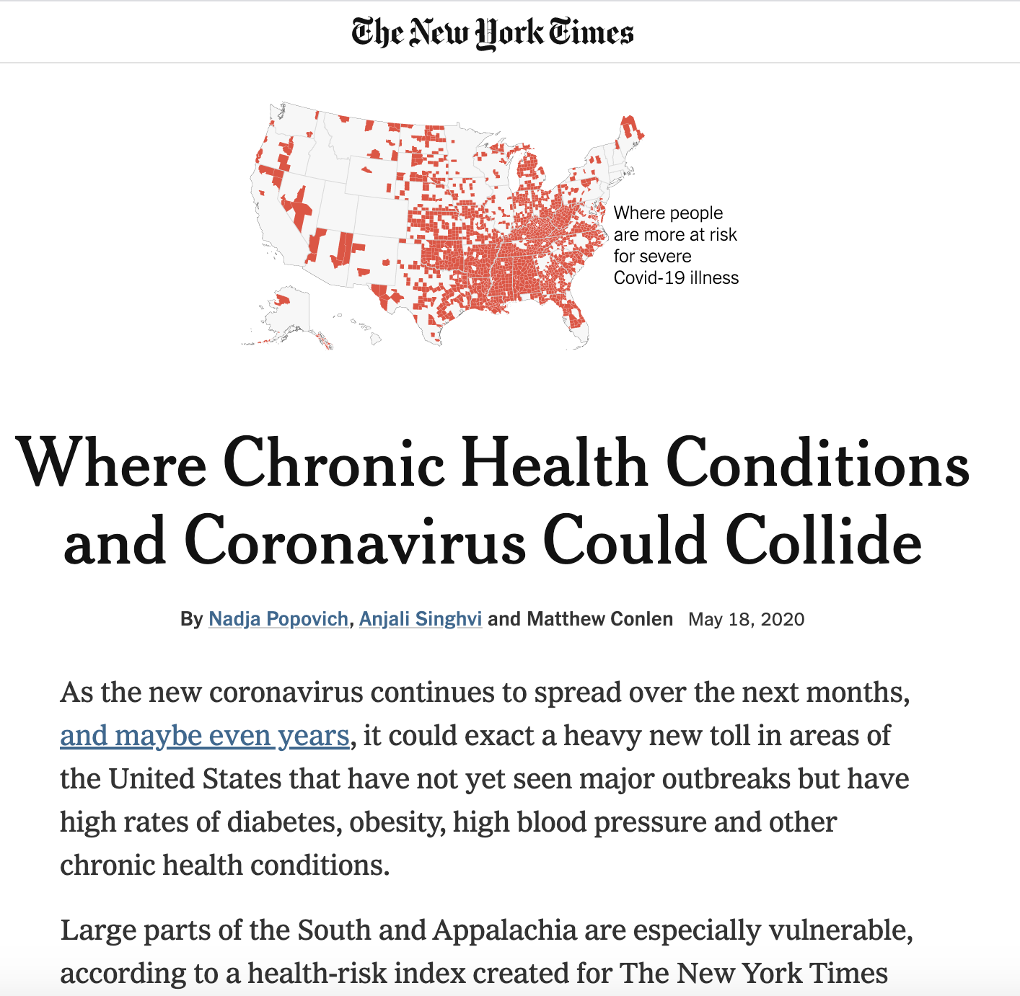
Relevance in a Pandemic
See Reference Appendix
Notes:
In pandemic times, LM couldn't be more important. COVID 19 is like a pandemic within a pandemic. Over and over US and global statistics demonstrate that patients suffering the gravest outcomes-hospitalization and death associated with COVID 19 are those with co-morbid conditions, largely lifestyle born co-morbid conditions. We know that lifestyle choices have general and even acute effects on immunity and chronic disease activity. And certainly, we have seen that regions and communities vulnerable to the most severe Covid outcomes are those who also have the highest rates of lifestyle born diseases such as diabetes, obesity, HTN, and other chronic conditions often due to health inequities. So along with physical distancing and vaccination, lifestyle is a foundational means to manage Covid and infectious pandemics in our future by reducing our chronic disease burden.

Slide 13
UK Lifestyle Intervention Diabetes Remission Clinical Trial: Economic Analysis
DM, aged 55
Life expectancy 13-21 years
Remission equates to 7-15 years of cost savings.
See Reference Appendix
Notes:
And LM is a means to address these burgeoning healthcare costs. This economic analysis out of the UK amplified something that we in LM focus on, that when possible, we try to aim for disease reversal or remission. This analysis essentially comparing the the cost of care of maintaining a diabetic on usual medication treatments over time to the cost of a lifestyle intervention leading to remission and elimination of medications. At 2 years, the intervention cost was more than standard care, but remission became cost saving within 6 years. So for a diabetic age 55 life expectancy ranges from 13-21 years, achieving remission equates to 7-15 years of cost savings. These type of analyses look at quality of life years, also known as Qalys.

Slide 14
Evidence-Based and Guideline Driven
Notes:
There are currently (June 2020) 56,889 references listed in PubMed with Lifestyle Medicine as a key search word. Science is supporting this rapidly growing field in medicine with volumes of research. Let me share with you some high level research findings and recommendations. You can source the 55,000 by starting with the citation sources at the end of the webinar and of course, by going to the ACLM websites where you find many many more.

Slide 15
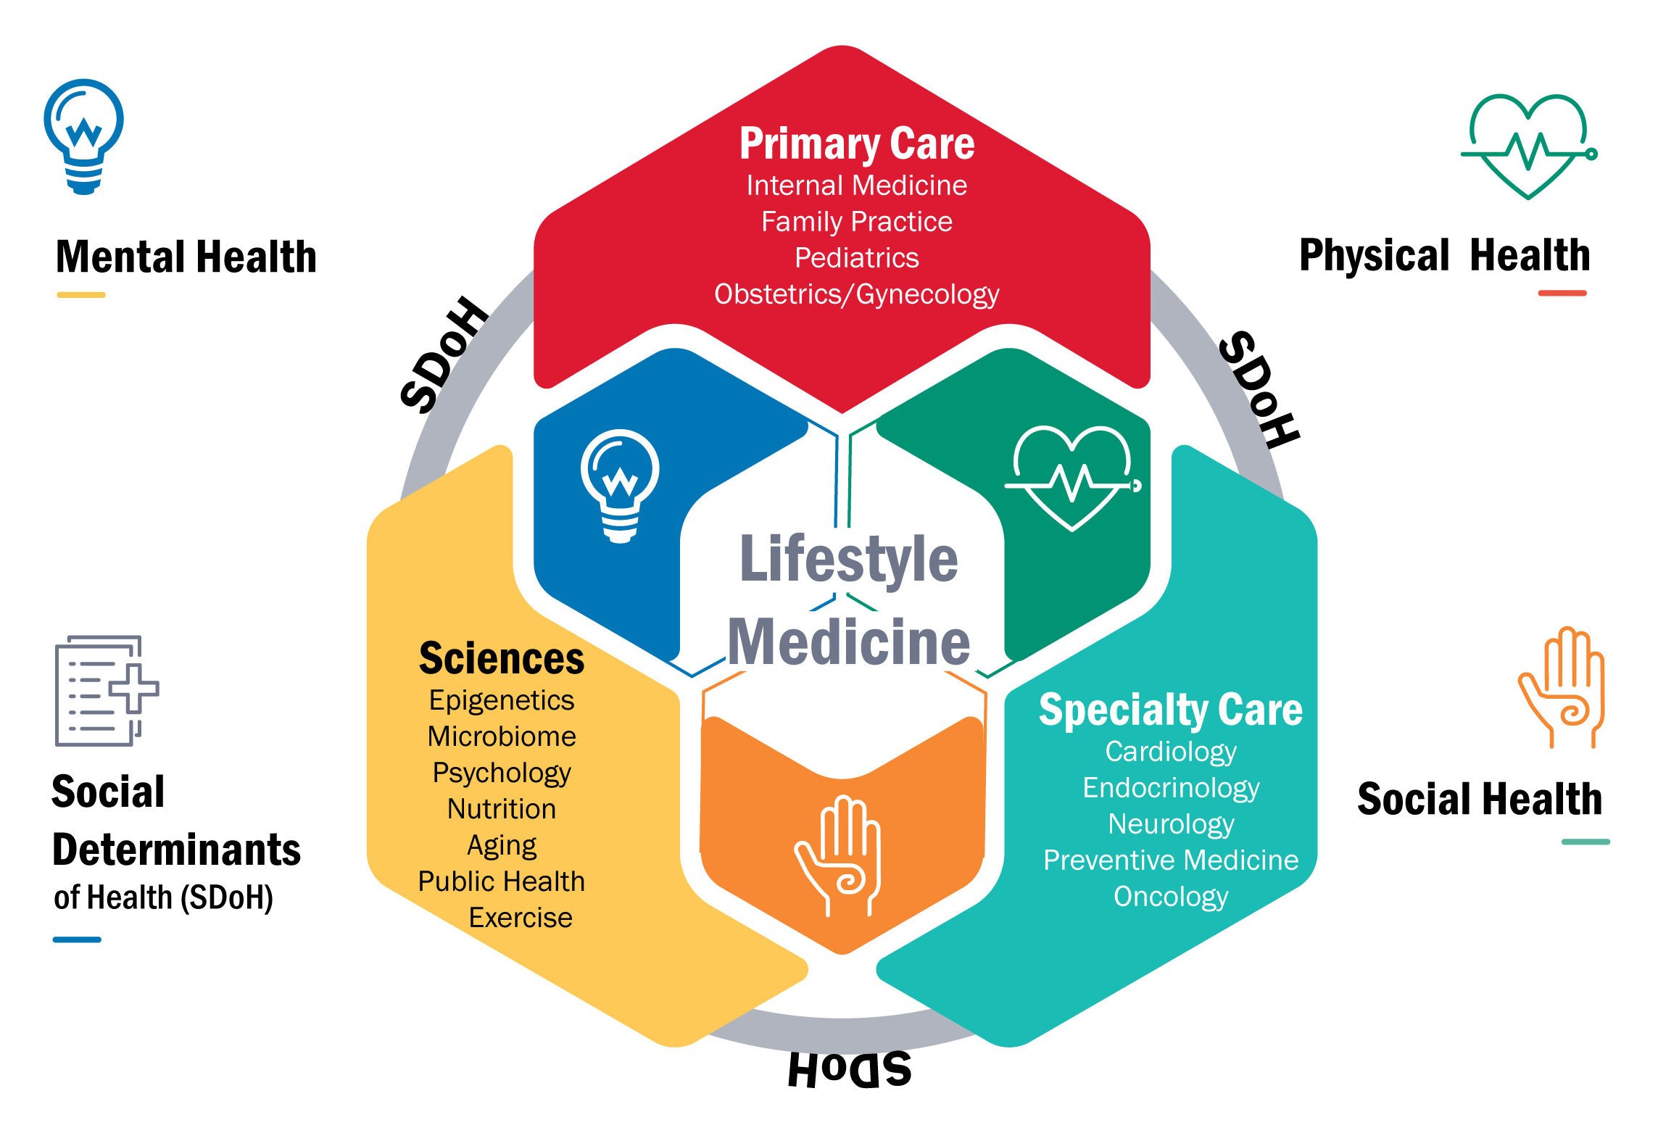
At the Center of Medicine, Science, and Health
Notes:
The 6 domains of LM draw from the research and evidence in many fields of science, not just those that have a key word of lifestyle in pub med. LM draws from the field of epigenetics, equally fascinating and rapidly advancing data and knowledge about the microbiome, as well as of course, psychology, nutrition, aging sciences, exercise sciences, and more. LM is applicable to both primary and specialty care and taken together with social determinants of health, aims to address not only physical health, but mental and social health holistic or if you will, addresses whole person healthcare.

Slide 16
Lifestyle Associated Pathogenesis
Notes:
I was very excited by a recent publication from the LM Research Summit. This was a summit where LM thought leaders and subject matter experts addressed the current state of knowledge with an eye to identify gaps in knowledge and provided recommendations for research priorities. They acknowledged where lifestyle interventions could modulate the microbiome, epigenetics, and cellular injury and in term, inflammation, a nonspecific but common pathway to the development of a wide array of conditions that we find are lifestyle born. And the hope is to use systems biology, big data, and computational modeling to accelerate our understanding of lifestyle interventions and solutions.
Front. Med., 22 December 2020 | https://doi.org/10.3389/fmed.2020.585744

Slide 17
Guideline Driven
2019 ACC/AHA Guideline on the Treatment of Blood Cholesterol to Reduce Atherosclerotic Cardiovascular Risk in Adults: A Report of the American College of Cardiology/American Heart Association Task Force on Practice Guidelines
Notes:
We see it in the ACC and AHA guidelines for cholesterol management as an example, where it is recommended to be intensive for young adults aged 20-39 and a primary intervention for metabolic syndrome at all ages. Having practiced cardiology for nearly 30 years, I'm not proud to say that these guidelines are not adhered to very well and pharmacologic means are all to often the first line and primary intervention

Slide 18
Guideline Driven
Notes:
And the American Diabetes Association recognizes lifestyle as fundamental, but all too often, metformin or other medications are prescribed before a nutritional and exercise intervention. We have the guidelines as a grounding but they are just not enough. LM becomes the vehicle to implementation.

Slide 19
Nutrition Interventions
Extensive scientific evidence supports the use of a whole-food, plant-based (WFPB) dietary pattern as treatment for diet-related chronic diseases.¹⁻⁵
WFPB dietary patterns increase the intake of nutrient dense, antioxidant-rich foods¹³ and decrease or eliminate exposure to dietary toxins¹⁴⁻¹⁸
Plant-based dietary patterns that approximate the WFPB pattern include the Mediterranean,⁶ Nordic,⁷ flexitarian,⁸ and vegetarian⁹ diets.
See Reference Appendix
Notes:
I'd like to shine a light on some of the evidence for each of the pillars or domains of LM and then show results when these multiple pillars are pulled together into LM programs. Clinicians practicing LM recognize the importance and attention to all 6 domains of lifestyle but nutritional interventions very often demand the most attention and yield some of the greatest benefit. Particularly through the lens of a goal to treat or reverse established disease, the balance of evidence supports the use of a WFPB eating pattern as the best nutritional intervention.

Slide 20
Exercise Interventions
Broad evidence to support recommendations for adults 18-64 years old is at least 150-300 minutes of moderate intensity, or 75-150 minutes of vigorous activity weekly along with two or more days weekly of strength training.¹
Integrating exercise as a vital sign into for every patient at every encounter elevates the importance of assessment and exercise prescription. ²
Extensive research for targeted interventions such high intensity exercise, isometrics, and exercise timing to target patients with diabetes, hypertension, and those undergoing cancer treatments.
See Reference Appendix
Notes:
Exercise is a key LM intervention. The 2018 Physical Activity Scientific Report provides the foundational evidence to recommend general physical activity guidelines and we know than integrating exercise as a vital sign elevates the importance for providers to assess and prescribe exercise. There is also extensive body of evidence in the exercise sciences to further tailor exercise prescriptions to address diabetes, hypertension and even patients undergoing cancer treatments to mitigate side effects of chemotherapy. High intensity protocols and specific exercise timing are all areas of importance in lifestyle medicine practices.

Slide 21
Sleep Management
Sleeping less than 6-8 hours a night increases the risk of early death by approximately 12 percent.²
Sleep provides protection from oxidative stress and is involved in the "glymphatic system" which clears waste and breakdown products.
Sleep apnea and other sleep disorders notably associated with CV, cardiometabolic, and neuropsychiatric risks.
Impaired sleep has a multidirectional effect on the other domains of lifestyle behavior change.
See Reference Appendix
Notes:
Sleep management is a vital pillar in lifestyle medicine and management. Sleep provides protection from oxidative stress and inflammation and sleep disorders are notably associated with cardiovascular conditions, cardiometabolic health, and neuropsychiatric risk. Attention to sleep is also important by way of it's multidirectional effect on other lifestyle behaviors and decisions.

Slide 22
Stress Management
Chronic or maladaptive stress responses can lead to impaired health and productivity or to anxiety, depression, obesity, CV disease, irritable bowel disease, and immune dysfunction and associated poor health outcomes. ²⁻⁴
Mind-body and cognitive behavioral therapies have been associated with improvements in immune function, chronic pain, CV disease, anxiety and depression.
Stress and maladaptive responses also have multidirectional effects on the other domains of lifestyle behavior and is an important pillar of lifestyle medicine care.
See Reference Appendix
Notes:
Stress management is another domain that falls under Lifestyle Medicine since research demonstrates that chronic or maladaptive stress produces impairment across multiple physiologic systems. We also know that methods to mitigate and manage stress have direct effects on these same systems. Like the other pillars, stress management is important as well through the multidirectional impact on other lifestyle behaviors and successful behavior change

Slide 23
Addictive Substance Management
Over 40 million Americans and another 80 million meet the clinical criteria for addiction or misuse of nicotine, alcohol or other drugs¹
The presence of an addiction or risky use doubles the risk of chronic conditions, such as arthritis, chronic pain, hypertension, heart disease, stroke, diabetes, and asthma.^{2, 3}
Treatment of substance use has often been relegated outside of the traditional healthcare setting, but substance misuse has a multidirectional effect on the other domains of lifestyle behavior change and is an important pillar to address in LM.
See Reference Appendix
Notes:
It is estimated that 40 million Americans meet the clinical criteria for addiction and another 80 million for misuse of substances and leaving aside MVA and injuries, the presence of addiction or misuse doubles the risk of chronic conditions. This is an important pillar to address in LM and may be the door through which patient begin to engage in other healthy lifestyle behaviors in their journey to recovery.

Slide 24
Social Connection As a Treatment
Unhealthy social relationships, isolation and loneliness are associated with increased mortality and morbidity especially among individuals with established lifestyle-related diseases.³⁻⁷
Micro-moments of human connectivity correlated with physiologic response.
Provider, coach, and allied health professional to patient connection is an "active ingredient" of lifestyle medicine treatments.
Multidimensional relationship with other lifestyle behaviors.
See Reference Appendix
Notes:
1. The is increasing interest and research to support the value of social connection as a treatment. Unhealthy social relationships or isolation are associated with increased mortality and morbidity, especially among individuals with established lifestyle related conditions and by contrast, we know that even micro-moments of human connectivity correlate with positive physiological responses. In LM, we also see that a positive connection between the provider and the patients or between peers as an "active ingredient" of successful lifestyle change. I believe it is Dr Dysinger who states that we heal through community
Bickart KC, Wright CI, Dautoff RJ, Dickerson BC, Barrett LF. Amygdala volume and social network size in humans. In: Nature Neuroscience. ; 2011. doi:10.1038/nn.2724
2. Ornish D. Love and Survival: The Scientific Basis for the Healing Power of Intimacy. New York: Harper Perennial; 1999.
3. Uchino BN, Cacioppo JT, Kiecolt-Glaser JK. The relationship between social support and physiological processes: A review with emphasis on underlying mechanisms and implications for health. Psychol Bull. 1996. doi:10.1037/0033-2909.119.3.488
4. Brummett BH, Barefoot JC, Siegler IC, et al. Characteristics of socially isolated patients with coronary artery disease who are at elevated risk for mortality. Psychosom Med. 2001. doi:10.1097/00006842-200103000-00010
5. Brinkhues S, Dukers-Muijrers NHTM, Hoebe CJPA, et al. Socially isolated individuals are more prone to have newly diagnosed and prevalent type 2 diabetes mellitus - The Maastricht study - The M. BMC Public Health. 2017. doi:10.1186/s12889-017-4948-6
6. Holt-Lunstad J, Smith TB, Baker M, Harris T, Stephenson D. Loneliness and Social Isolation as Risk Factors for Mortality: A Meta-Analytic Review. Perspect Psychol Sci. 2015. doi:10.1177/1745691614568352
7. Hawkley LC, Cacioppo JT. Loneliness matters: A theoretical and empirical review of consequences and mechanisms. Ann Behav Med. 2010. doi:10.1007/s12160-010-9210-8
8. Waldinger R. The Harvard study--What makes a good life? Lessons from the longest study on happine. TED.
9. The Harvard Study of Adult Development. www.adultdevelopmentstudy.org.
10. Sandstrom GM, Dunn EW. Social interactions and well-being: The surprising power of weak ties. Personal Soc Psychol Bull. 2014. doi:10.1177/0146167214529799
11. Uchino BN, Trettevik R, Kent de Grey RG, Cronan S, Hogan J, Baucom BRW. Social support, social integration, and inflammatory cytokines: A meta-analysis. Heal Psychol. 2018. doi:10.1037/hea0000594

Slide 25
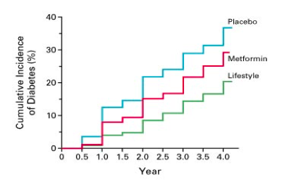
Lifestyle change has the power to prevent disease
Diabetes Prevention Program (DPP) “science in action)
58% Reduction in incidence
Real Life Example of Lifestyle Medicine
Notes:
Now let's look at the results of programs where these pillars have been woven together . In the lens of prevention, The DPP program data shows more than a 50% reduction in progression from pre diabetes to diabetes and now has means of reimbursement . Most of us accept that lifestyle has the power to prevent disease.
Diabetes Prevention Program Research Group 346 (6): 393, Figure 2, February 7, 2002, NEJM

Slide 26
Lifestyle Intervention Compared to Usual Diabetes Support and Education
See Reference Appendix
Notes:
This is a study looking patients with established T2D that comes out of the Look AHEAD Research group. This was a large study of 4500 US adults randomized to one of 2 programs: Intensive Lifestyle Intervention involving dietary and exercise intervention or what was defined as usual care with Diabetes Support and Education
Lifestyle intervention participants lost more weight, had greater fitness, more likely to experience partial or complete remission off diabetic medications at years 1 and 4 than patients in usual care.
I think is a great example of the difference between lifestyle counseling and lifestyle intervention.

Slide 27
Intensive Cardiac Rehabilitation: A Premier Lifestyle Intervention for Patients with Moderate to Severe CAD
Improved coronary angiographic results
Improved laboratory and biometrics measures
Improved quality of life and measures of emotional well being
Improved myocardial perfusion
Decreased angina
Fewer cardiac events
Reduction in the need for surgery
Notes:
Intensive Cardiac Rehab is another example of an intervention that utilizes all the domains of lifestyle interventions. Much of this data comes from the work of Dr. Dean Ornish showing improvements. Research grounded multidimensional approach to patients with established CAD.
Graphics and Published article – Ornish,
- Ornish Lifestyle JAMA 1998, Vol 280 Ed 23, 2001-7
- Ornish, Lancet 1990, 336, 129-33
- Gould KL, JAMA, 1995, Vol 274 Ed 11, 894-901
- Ornish, AJC, 1998 Vol 82, 72T-76T

Slide 28
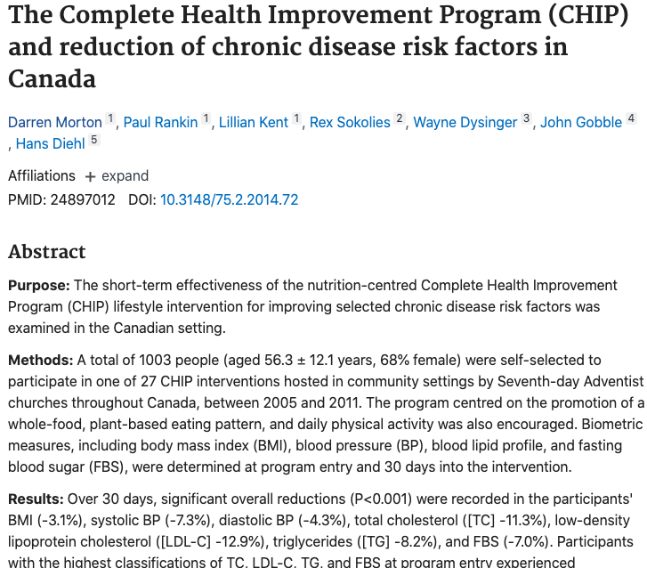
Complete Health Improvement Program: First Certified ACLM Program
See Reference Appendix
Notes:
There are also a number of publications on the Complete Health Improvement Program, which is the first certified ACLM LM program. CHIP program is a whole person program embracing all of the domains of LM. This particular study reports out on 1000 patients at 30 days. Patients in the highest risk quadrant demonstrated a

Slide 29
CHIP intervention in the highest risk patients has impressive 30-day results
44.1 % decline in triglycerides (initial > 500mg/dl)
19.9% decline in fasting plasma glucose (initial > 125mg/dl)
19.8% decline in total cholesterol (initial >280mg/dl)
16.1% decline in LDL cholesterol (initial > 190mg/dl)
10.4% decline in participants with metabolic syndrome
3.2 % decline in body mass index
Notes:
Patients in the highest risk: those with the most advanced levels of either hyperlipidemia, blood glucose, or body mass index had tremendous 30 days results

Slide 30
Lifestyle Medicine in Practice
The Power to Treat Chronic Disease
Notes:
Now let's look a bit at LM in practice. So many of our members have developed successful ways to practice LM Each of them often has their own secret sauce and their methods has been tailored to their patient population or their insurance profiles. And so while there are differences, most of them draw from a variety of tools

Slide 31
Lifestyle Medicine Approach in Clinical Settings
Starts with comprehensive lifestyle behavior assessment
LM team of specialists including a coach, nutritionist, and an exercise specialist
Novel methods such as shared medical appointments, culinary medicine, and digital health tools.
Facilitation through coaching and behavioral psychology as a core
Notes:
Some method of acquiring a comprehensive and detailed assessment of lifestyle is used. A tool for this can be found under practice resource on the ACLM website or acquired through a digital means .
Many LM providers utilize a team approach with coach, a nutritionist, some have an exercise specialist involved. Allied providers of all types are often part of the team.
Many providers utilize SMA, culinary medicine and cooking demonstrations to foster education and behavior change and as a means to reimbursement. Some utilize digital health and remote patient monitoring to foster frequent touch points and as a means of reimbursement.
LM is very much a behavior change specialty so behavioral psychology and coaching mindset are at it's core.

Slide 32
“One of the most powerful aspects of Lifestyle Medicine is that patients become more engaged, active participants in their own self-care, disease prevention and management, and overall well-being.”
Cindy Geyer, MD
Notes:
And really, a quote by Dr. Cindy Geyer, expresses the power of LM is that
And this is so rewarding for both patients and their providers.

