Slide 1

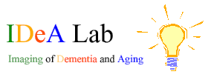

Life’s Simple 7
What You Can Do To Improve Your Brain Health
Charles DeCarli, MD
Victor and Genevieve Orsi Chair in Alzheimer's Research
Director University of California at Davis, Alzheimer’s Disease Center

Slide 2
Framingham Heart Study, unpublished data

Slide 3
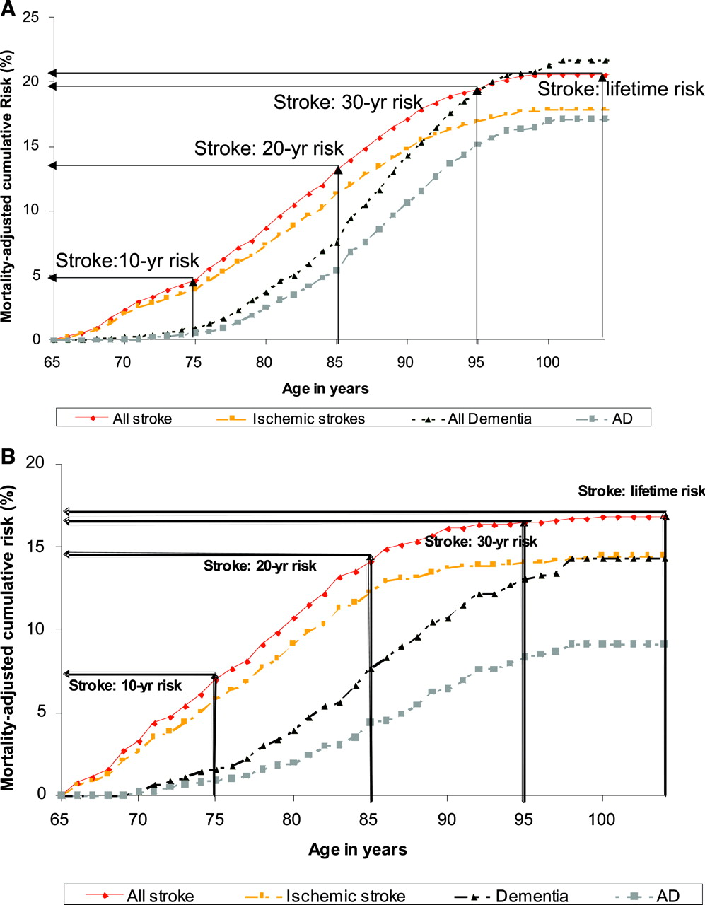
Women
Future Risk of Stroke or Dementia at Age 65
Men
Seshadri, S. et al. Stroke 2006;37:345-350

Slide 5

Increasing odds of Dementia with Number of Vascular Risk Factors
Whitmer, et al, Neurology, 2005
~74% Caucasian
Luchsinger, et al, Neurology 2005
~23% Caucasian

Slide 6
Pathology of Dementia

Slide 7
Vascular Pathology of Dementia

Slide 8
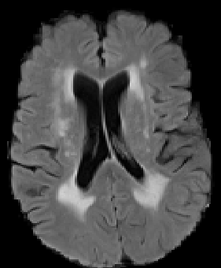
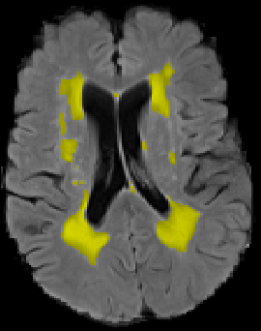
Markers of Subcortical Vascular Disease

Slide 9
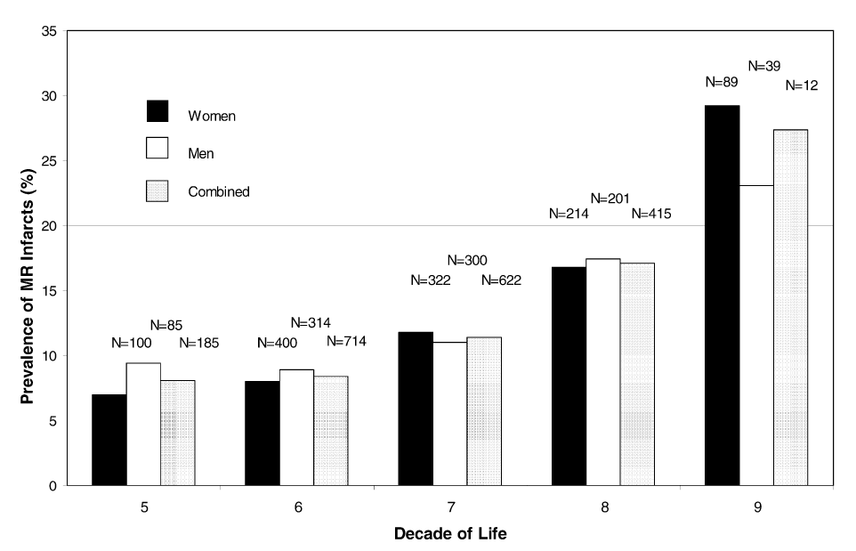
Prevalence of MRI Infarcts
DeCarli, et al. Neurobiology of Aging, 2005

Slide 10
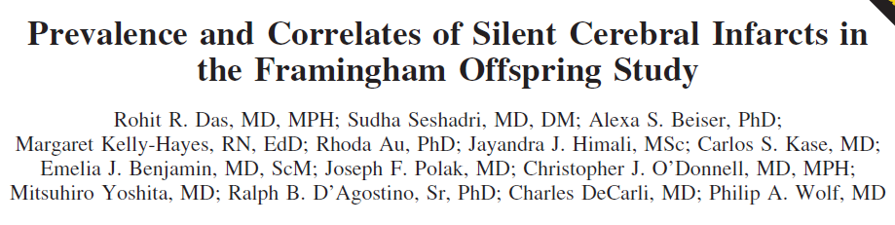
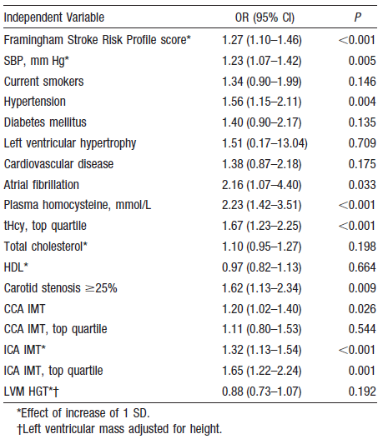
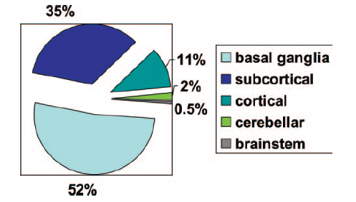

Slide 11
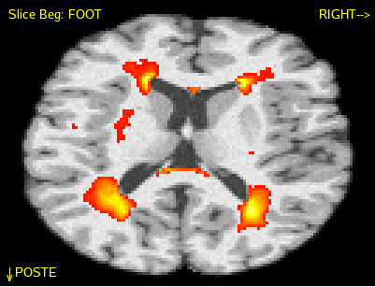
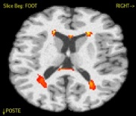
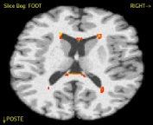
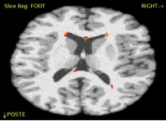
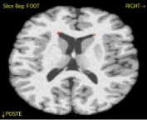
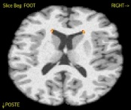
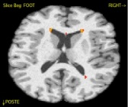
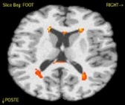

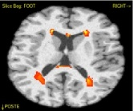
Aging White Matter Disease
0.30
0.29
0.25
0.23
0.20
Vascular Risk
DeCarli, et al. Neurobiology of Aging, 2005

Slide 12
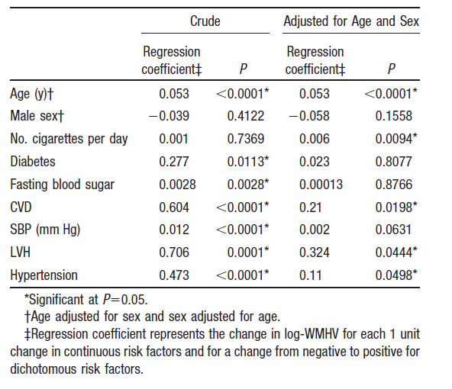

Slide 13
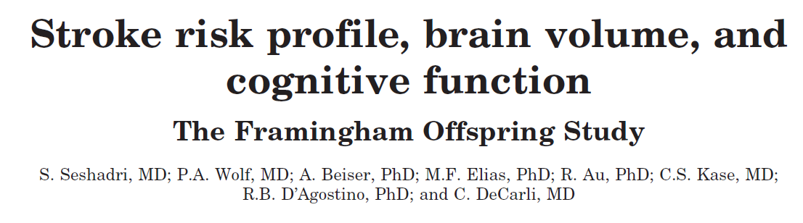

 | Women | Men
SBP | 123 + 20 | 127 + 16
HTN Rx | 15% | 18%
Diabetes | 4% | 7%
Smoker | 16% | 17%
History of CVD | 4% | 8%
Atrial fibrillation | 0.2% | 0.7%
ECG- LVH | 4% | 14%
FSRP score | 0.023 + 0.034 | 0.048 + 0.043

Slide 14
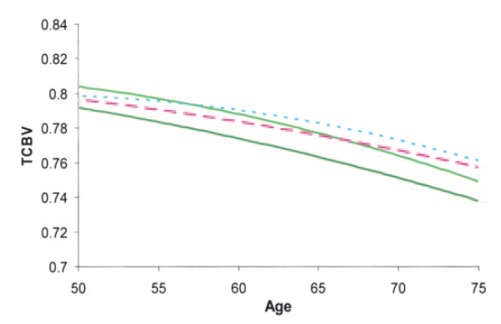
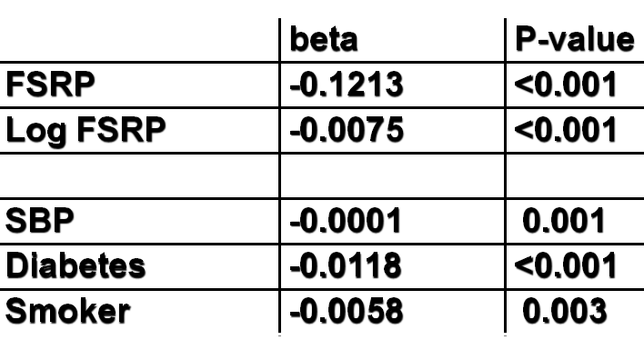
Risk Factors, Age and Brain Volume

Slide 15
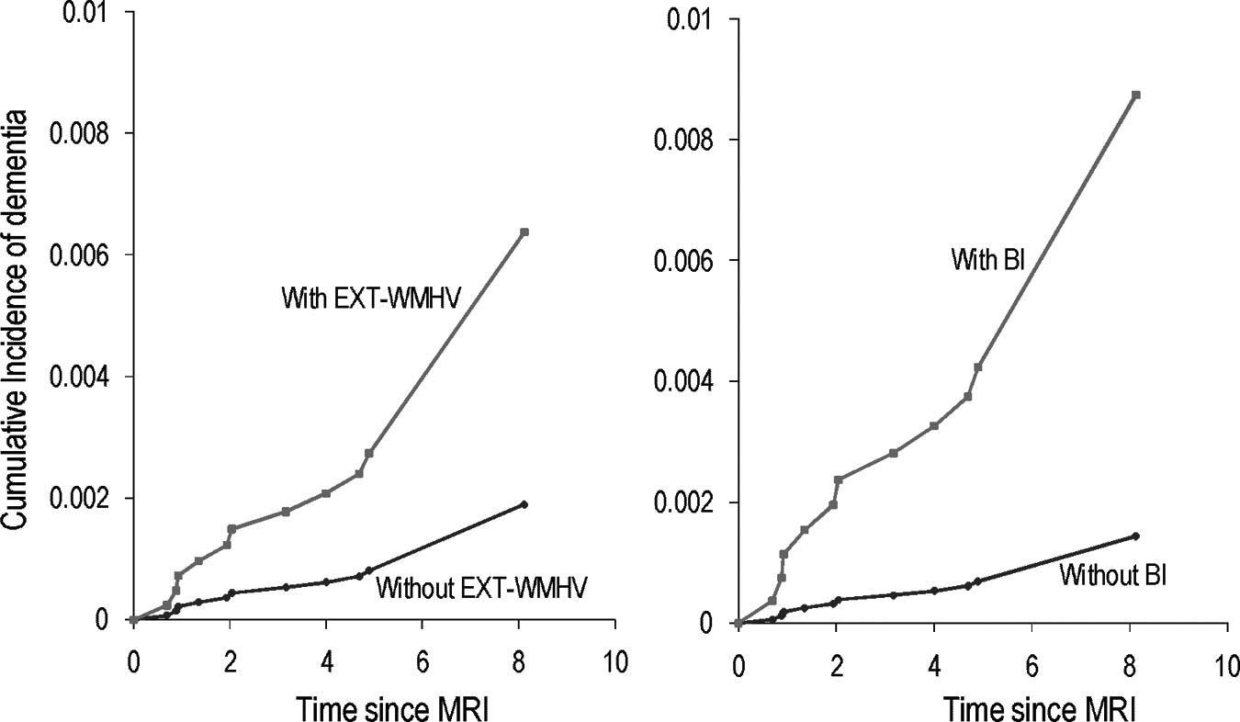
Dementia Risk with MRI Vascular Measures
Debette et al, Stroke, 2010

Slide 16
Hypothetical Model of Vascular Disease and Brain Injury

Slide 17
Summary
Vascular risk factors and consequential vascular disease is common to the aging process
Vascular risk factors lead to subclinical brain injury and increases risk for dementia
Vascular pathology commonly accompanies Alzheimer’s disease in dementia

Slide 18

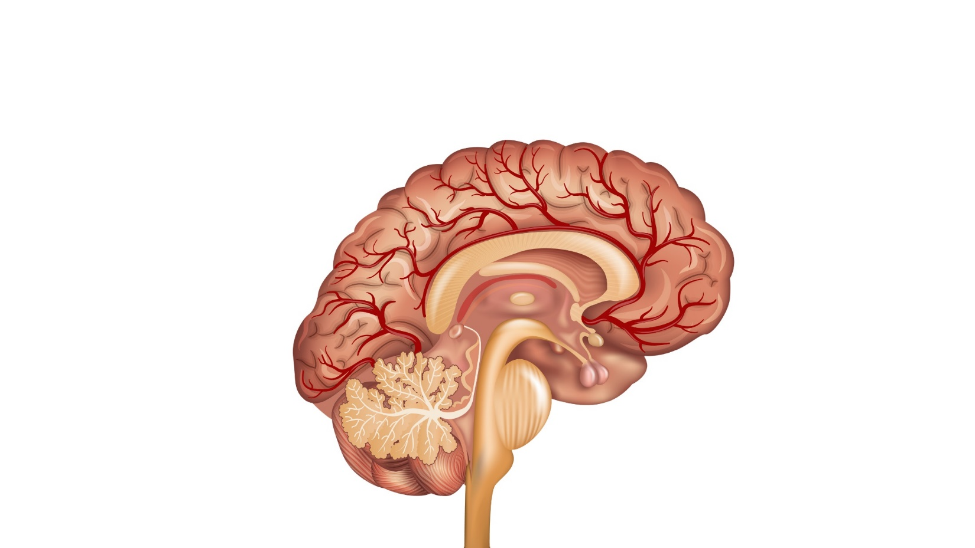

IMPROVING
COGNITIVE AGING
Cognitive Ability
Brain
Injury
Reduce Injury
0
30's
40's
50's
60's
70's
80's
90's
Age (years)
Notes:
The goal of this “Big Idea” is to understand the basic biological processes that lead to age-related brain injury and modify them. In addition, we aim to understand how brain resilience can be enhanced and finally develop methods that will support individuals who have some cognitive impairment.

Slide 19
Impact of Intervention

Slide 20
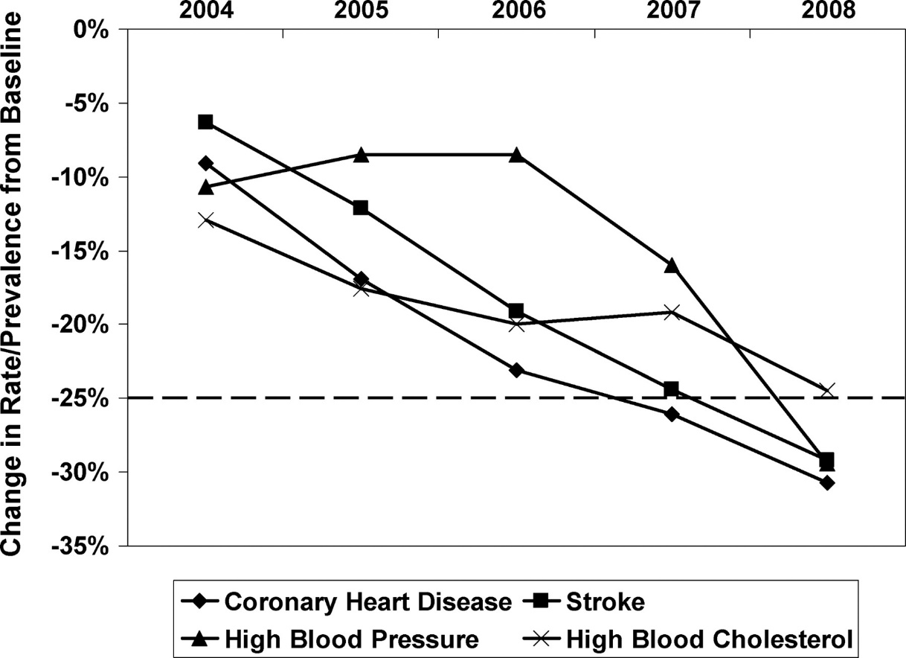

Trajectory of mortality rates from CHD and stroke, rate of uncontrolled high blood pressure, and prevalence of high blood cholesterol from 2004 to 2008.
Donald M. Lloyd-Jones et al. Circulation. 2010;121:586-613
Copyright © American Heart Association, Inc. All rights reserved.
Notes:
Figure 1. Trajectory of mortality rates from CHD and stroke, rate of uncontrolled high blood pressure, and prevalence of high blood cholesterol from 2004 to 2008.

Slide 23
A Few Words About Diet
Dietary habits show strongest evidence for causal effects on cardiovascular events, diabetes, and/or obesity
Recommend dietary pattern based on foods rather than nutrients
Inclusion of as few as possible elements with minimal overlap with each other while at the same time having some overlap with other relevant dietary guidelines

Slide 24
Dietary Approaches to Stop Hypertension (DASH)
Fruits and vegetables: ≥4.5 cups per day
Fish: ≥two 3.5-oz servings per week (preferably oily fish)
Fiber-rich whole grains: ≥three 1-oz-equivalent servings per day
Sodium: <1500 mg per day
Sugar-sweetened beverages: ≤450 kcal (36 oz) per week

Slide 25
Secondary Dietary Metrics
Nuts, legumes, and seeds: ≥4 servings per week
Processed meats: none or ≤2 servings per week
Saturated fat: <7% of total energy intake

Slide 26
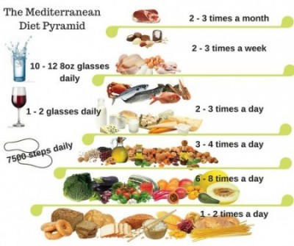
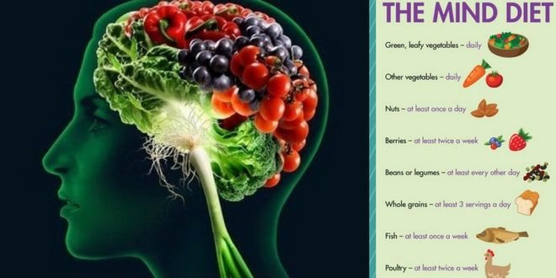
Other
Diets

Slide 27
Whites
African Americans

Slide 28
Study Design
17,761 Individuals > 45 years of age
  Free of Stroke and Dementia
Study Duration: 2003-2012
Biennial Assessment of Cognition
  Word list immediate and delayed recall
  Animal fluency

Slide 29
Definition of Impairment
Less than 1.5 sd of mean based on age, race, gender and education
Must have 2 or more of the 3 test components at this level

Slide 30
Impact on Cognition

Slide 31
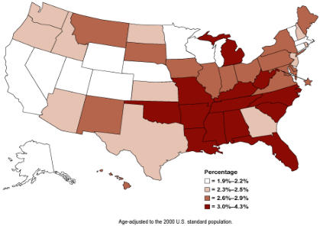
Impact on Cognition

Slide 32
Impact of
Individual
Components

Slide 34
Impact on Cognition and Brain

Slide 38
Recommendations for Promotion and Maintenance of Optimal Brain Health

Slide 39
IMPROVING
COGNITIVE AGING
Cognitive Ability
Brain
Injury
Reduce Injury
0
30's
40's
50's
60's
70's
80's
90's
Age (years)
Notes:
The goal of this “Big Idea” is to understand the basic biological processes that lead to age-related brain injury and modify them. In addition, we aim to understand how brain resilience can be enhanced and finally develop methods that will support individuals who have some cognitive impairment.

Slide 40
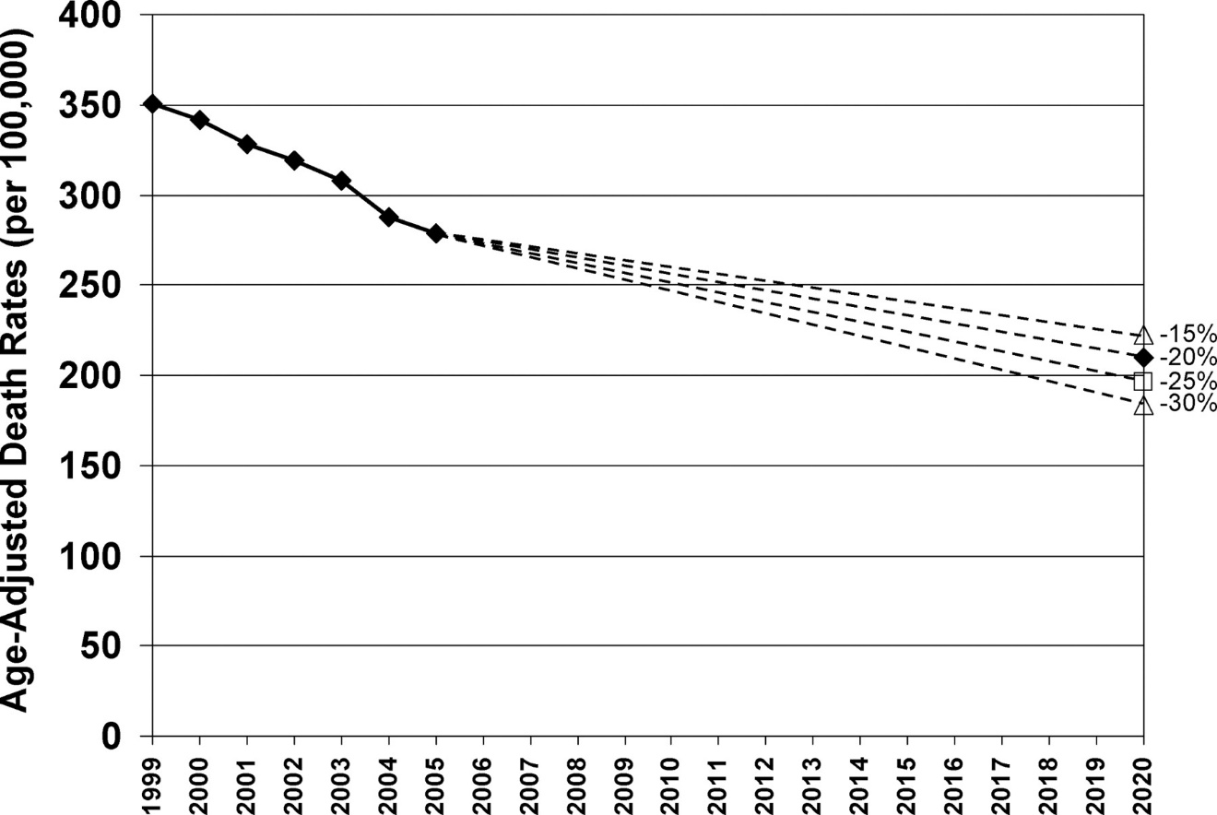
Age-adjusted death rates (per 100 000) due to all CVDs and stroke in the United States from 1999 to 2005 and potential further declines in CVD and stroke death rates from 2005 through 2020.
Donald M. Lloyd-Jones et al. Circulation. 2010;121:586-613
Copyright © American Heart Association, Inc. All rights reserved.
Notes:
Figure 2. Age-adjusted death rates (per 100 000) due to all CVDs and stroke in the United States from 1999 to 2005 and potential further declines in CVD and stroke death rates from 2005 through 2020.

Slide 41
Conclusions
Treatment of vascular risk factors and promotion of “vascular health” is likely to have a strong public health benefit to reduce late-life dementia
Current efforts to improve vascular health with “Life’s Simple 7” provide a public health opportunity to assess the efficacy of this approach

Slide 42
Life’s Simple 7
Don’t Smoke
Watch Your Weight
Eat A Healthy Diet
Exercise
Control Your Blood Pressure
Control Your Blood Sugar
Control Your Blood Cholesterol

Slide 43
Life’s Simple 7
Don’t Smoke
Watch Your Weight
Eat A Healthy Diet
Exercise
Control Your Blood Pressure
Control Your Blood Sugar
Control Your Blood Cholesterol

Slide 44
Life’s Simple 7
Don’t Smoke
Watch Your Weight
Eat A Healthy Diet
Exercise
Control Your Blood Pressure
Control Your Blood Sugar
Control Your Blood Cholesterol

Slide 45
Life’s Simple 7
Don’t Smoke
Watch Your Weight
Eat A Healthy Diet
Exercise
Control Your Blood Pressure
Control Your Blood Sugar
Control Your Blood Cholesterol

Slide 46
Life’s Simple 7
Don’t Smoke
Watch Your Weight
Eat A Healthy Diet
Exercise
Control Your Blood Pressure
Control Your Blood Sugar
Control Your Blood Cholesterol

Slide 47
Life’s Simple 7
Don’t Smoke
Watch Your Weight
Eat A Healthy Diet
Exercise
Control Your Blood Pressure
Control Your Blood Sugar
Control Your Blood Cholesterol

Slide 48
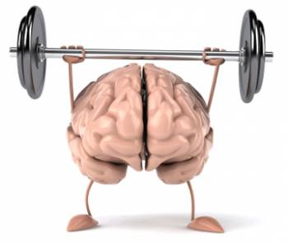
Life’s Simple 7
Don’t Smoke
Watch Your Weight
Eat A Healthy Diet
Exercise
Control Your Blood Pressure
Control Your Blood Sugar
Control Your Blood Cholesterol

Slide 49

U.S. POINTER: Study Design and Trial Kick-Off
Sarah Farias, PhD
University of California Davis
US POINTER Northern CA Co-PI

Slide 50
  BMI was lower in the tx group compared to controls at end of 2 years
  Dietary habits were better
  Physical activity was higher
Extended 5- & 7-year follow-up ongoing…
Notes:
FINGER trial description – on which U.S. POINTER is modeled

Slide 51
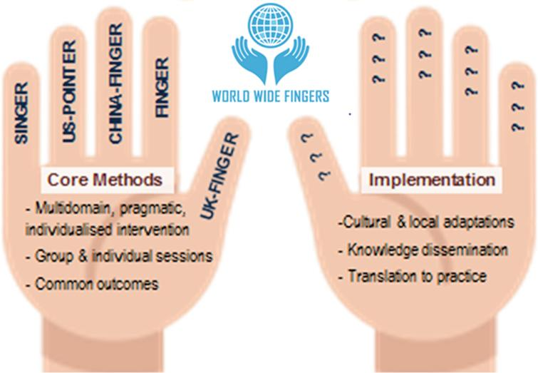
FINGER-like multidomain interventions will be adapted and tested across cultures
Develop prevention strategies and programs that are accessible, feasible, sustainable and cost effective
Other goals
  Harmonization of methods and outcomes across sites
  Data sharing and collaboration across sites to produce robust results on a large scale

Slide 52

UC-Davis
Wake Forest
Recruitment
2 Vanguard Sites identified
3 sites TBA

Slide 53







Interventions
Self-Guided Lifestyle Intervention
Structured Lifestyle Intervention
Exercise (mostly aerobic): 4x per week primarily at a YMCA
Nutrition: MIND diet (modified Mediterranean and DASH)
Cognitive Stimulation: Computer cognitive training (BrainHQ), regular group meetings to encourage social/intellectual challenge
  Education & Support: Group meetings 2-3 times per year to provide tangible resources & encouragement to support self-selected plans
Guideline-Based Health Coaching: Frequent exams, blood tests & goal-setting
Guideline-Based Health Monitoring: Annual physical exam & blood tests

Slide 54
What is the Point of POINTER ?
To test whether FINGER findings can be replicated in a heterogeneous cohort of older Americans who are at risk for cognitive decline and AD, using a more pragmatic trial approach
To adapt FINGER lifestyle interventions to fit into American culture
To identify and develop a community-based infrastructure that could support a sustainable brain health lifestyle program if the trial results are positive

Slide 55
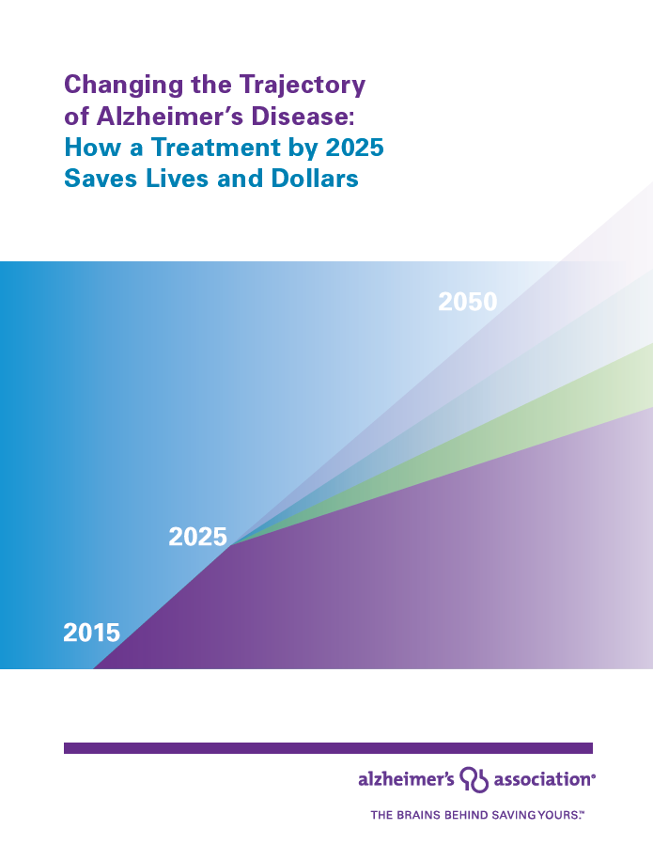
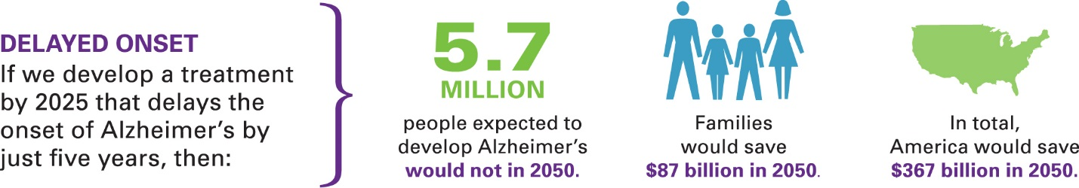
If we delay onset by 5 years…

Slide 56


THANK YOU
Charles DeCarli, MD
UC Davis Alzheimer’s Disease Center
Imaging of Dementia and Aging (IDeA) Laboratory
Notes:
Thank you.

