Slide 1

Diabetes Team Based Care: An IPA Story
Andrea De Coro, PharmD
Kristi March, PharmD
Brian Coyne, MD
August 12, 2019

Slide 2
Agenda
Program Background
Results
Team Perspective
PCP Perspective
Patient Perspective
Lessons Learned

Slide 3
Organizational Overview

Slide 4


Spotlight

Slide 5

Roles
Andrea De Coro, PharmD
  MemorialCare Medical Foundation (MCMF)
  Ambulatory Care Clinical Pharmacist
  VP, Clinical Pharmacy Services and Performance Improvement
Kristi March, PharmD, BCPS, CDE
  MemorialCare Medical Foundation (MCMF)
  Ambulatory Care Clinical Pharmacist
  Manager, GNP Care Clinics
Brian Coyne, MD
  Greater Newport Physicians (GNP)
  Family Medicine Physician
  Physician Leader/Champion

Slide 6

We Choose Diabetes
PCP request challenging population-poorly controlled diabetics
Failures despite aggressive management
IHA/AMP Measure
Measurable metrics
Actions taken today have dramatic impact

Slide 7

How We Started
Grant
Partnership
Multidisciplinary team
  PCP
  Endocrinologist, PharmD, NP, Dietitian, Social Worker
  Create “swim lanes” to ensure top of license practice

Slide 8

ACTIVE Diabetes Program
ACTIVE
Access
Coach
Treat
Integrate
Value
Empower

Slide 9
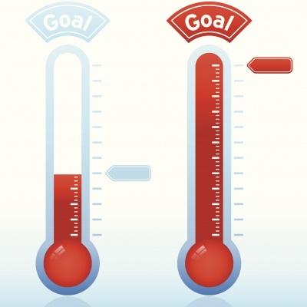
ACTIVE Diabetes Program
Target:
Poorly controlled diabetics (A1c >8)
Goal:
Improve A1c control in 30% of patients
Engage patients through individualized approach

Slide 10
ACTIVE Diabetes Baseline (2012)

Slide 11
ACTIVE Diabetes Results (2012)

Slide 12
ACTIVE Diabetes Results versus IHA 90th Percentile (2012)
IHA 90th %

Slide 13
Results
Results: ACTIVE Diabetes Clinic Results vs IHA 90th Percentile
IHA 90th

Slide 14

ACTIVE Diabetes Program
How it works
  Referral based
  Initial focus on A1c >8%
  Lifestyle modification for newly diagnosed diabetes/prediabetes
  Adults 18+
  DX: Type 1 and Type 2 Diabetes
  Patient

Slide 15

ACTIVE Diabetes Program
How it works
  Pharmacist led program
  Multidisciplinary team
  Intensive support
  Individualized care
  Address quality metrics

Slide 16


Team
Pharmacist Role:
Create individual care plan to improve blood sugar through medication management (includes blood pressure and statin therapy)
Critically assess and select the most appropriate medication choice/dose
Protocol based on ADA guidelines
Address comorbidities/screenings/referrals

Slide 17

Team
Dietitian Role:
Educate on importance of healthy nutrition and physical activity
Identify areas of opportunity and create individual goals
Lifestyle modification for pre-diabetes and newly diagnosed diabetes patients

Slide 18

Team
Social Worker Role:
Identify barriers to poor control
Create individual care plan to address barriers
Empowers-self care and goal-setting
Depression screening/referrals
Routine follow-up on all of the above

Slide 19
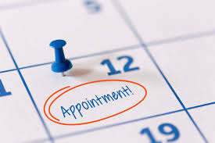
Operations: Appointments and Follow-up
2 locations: Fountain Valley and Irvine
Clinic hours are Mon-Fri, 9am to 5pm
Approximately 500 patients
New patient visits: ~1.5 hrs
Follow-up visits: 30 min to 1 hr (every 4-8 wks)
Follow up mostly in clinic (also telephonic)
Notes communicated in EMR
Graduation criteria: Maintain A1c at goal for 12 months

Slide 20

PCP Input…
Brian Coyne, MD
“I don't think I can stress enough how much MORE the PCPs value the care given to our diabetics by the pharmacists in Active Diabetes than by the endocrinologists, whose resources to track and educate our patients are just as limited as the PCPs. There's better follow up and better results.”
Peter Kim, MD
“The Active Diabetes Program helps my most challenging patients reach their goals, and makes it much easier to manage them. What PCPs lack – time to educate, convince, and microadjust therapies – the Program provides with well-trained and outcomes-focused pharmacy staff. Patients love their results, and the ROI and satisfaction scores can’t be beat. Highest recommendation.”

Slide 21
Case Example
Mr. M is currently a 38 year old male diagnosed with DM2 in 1996
Enrolled by his PCP in ACTIVE Diabetes clinic after A1c rose to 10.1 in 2016
Concerns include obesity, erratic mealtimes and glucose checks, high carbohydrate meals, financial difficulties
With additional support from available cost-reducing programs, dietician, frequent reminders, and long-acting insulin adjustment A1c improved to 6.8%

Slide 22
Case Example
Mr. L is currently a 72 year old male diagnosed with DM2 in 2008
Enrolled in ACTIVE Diabetes clinic with A1c of 13.1
Concerns include obesity, poor vision interfering with correct insulin dosing, noncompliance with diet (skipping meals, frequent high carbohydrate meals) and noncompliance with medications due to financial difficulties
With intensive education and medication adjustment A1c improved to 8.2% on most recent testing

Slide 23
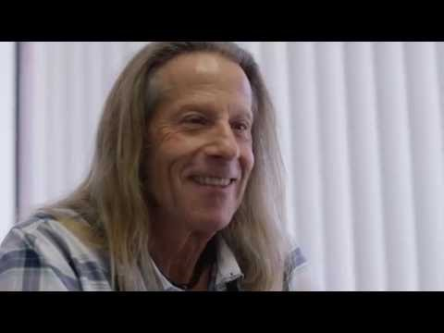
Joseph’s Story
https://www.youtube.com/watch?v=0mEOkBcVWLE

Slide 24
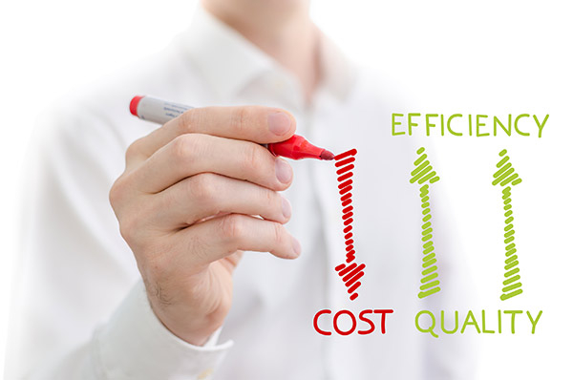
Cost Reduction/ROI
Patients enrolled in ACTIVE
  Medical Cost Savings per patient= $1,158/year
  Minus cost of the program the savings= $90/year
Enrolling more patients increases ROI
Notes:
I am going to wrap the discussion up with our ROI and then lessons learned.
We wanted to share a high level ROI with you, and how we calculated it was we compared a cohort of patients with an A1c>8, NOT enrolled in the ACTIVE Diabetes Program to the ACTIVE population.
We looked at hospital costs, ED, FFS endocrinology costs and other costs, in the end, we found patients

Slide 25

Lessons Learned
Must have PCP buy in
Don’t need a large team but you do need the right team
Funds itself through lowering medical expenses
Future funding (BlueShield pilot)
Break even is enough of a ROI, the right thing to do
Focus on one thing allows you to do it well

Slide 26
Thank you.

